Slide 1
Glymphatics

Slide 2
Causas del Dolor de Cabeza:
Problema neurologico todavia no bien comprendido
Inflamacion meningea asociada con
estancamiento de productos del metabolismo cerebral
Cambio la permeabilidad de la barrera ematoencefalica
Aumento de la produccion de liquido cefalo raquidio
Reduccion en la reabsorpcion del liquido cefalo raquidio
Analogia con el sistema linfatico periferico

Slide 3
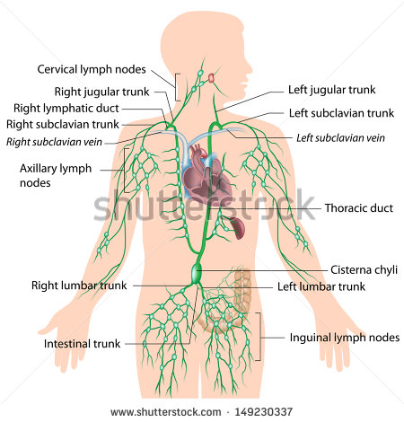
Movimiento del liquido linfatico
Los vasos linfaticos transportan la “linfa” usando la presion del corazon junto con un sistema de valvulas
NO EXISTE EN EL CEREBRO

Slide 4
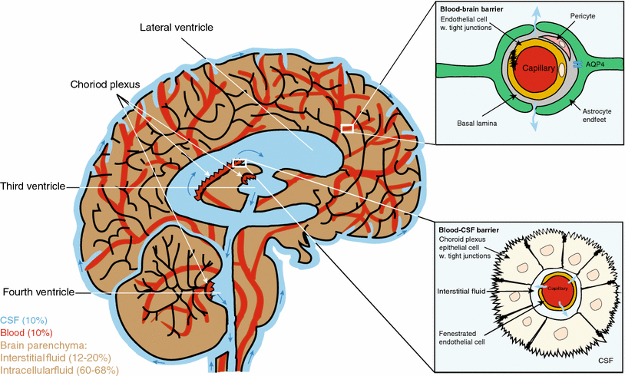

Slide 5
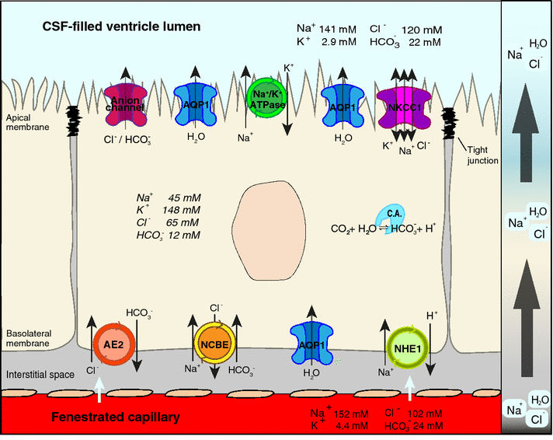

Slide 6
Produccion de liquido cefalo raquidio
The final result of these processes at the choroid plexus epithelium is
a net flux of Na⁺, HCO₃⁻ and Cl⁻ from the blood across the epithelium to the ventricles,
2) which generates the osmotic gradient that makes
3) water move from the blood to the ventricles across the choroid plexus epithelium through AQP1
4) thereby producing the CSF

Slide 7
Falta de informacion sobre la produccion del LCR
Despite decades of research, surprisingly little is known about the physiological processes regulating CSF production.
It is expected that CSF production is regulated by intracranial pressure, but existing reports are contradictory
and suggest that intracranial pressure must be increased significantly or chronically to suppress CSF production
Additionally, CSF production might also be regulated by the autonomic nervous system, but again the literature is complex possibly reflecting the technical limitations associated with quantifying CSF production

Slide 8
Remocion del LCR
CSF is continuously produced. In humans and mice CSF is renewed approximately four and 12 times each 24 h, respectively, and the total CSF volume of 150–160 mL in human and 0.04 mL in mice is kept constant by removal of CSF.
CSF is drained into the peripheral lymphatic system by efflux via the olfactory bulb and along cranial and spinal nerves.
Efflux along cranial and spinal nerves and the olfactory route might represent the most important efflux pathways for CSF.

Slide 9
Glymphatics: Drenaje
CSF movement into the parenchyma drives convective interstitial fluid fluxes within the tissue toward the perivenous spaces surrounding the large deep veins.
The interstitial fluid is collected in the perivenous space from where it drains out of the brain toward the cervical lymphatic system.
This highly polarized macroscopic system of convective fluid fluxes with rapid interchange of CSF and interstitial fluid was entitled the
glymphatic system based on its similarity to the lymphatic system in the peripheral tissue in function, and on the important role of glial AQP4 channels in the convective fluid transport.

Slide 10
Importancia del glymphatics en el metabolismo de los lipidos cerebrales
The human brain weighs 2 % of the body’s total weight but contains 25 % of the cholesterol in the human body [56]. Despite the brain being highly enriched in cholesterol, the blood–brain-barrier prevents influx of lipids and lipoproteins, including cholesterol, from the blood to the brain.
Unlike peripheral tissues, which obtain blood-borne cholesterol secreted by the liver, the brain synthesizes all its cholesterol de novo. Excess cholesterol is eliminated from the brain by hydroxylation of cholesterol to 24-OH cholesterol. In fact, 80 % of the 24-OH cholesterol in the body is found in the brain and the circulatory system acts as sink for excess cholesterol produced in the brain
Thus, Apolipoprotein E production is co-localized with CSF production sites and transport pathways suggesting that lipids are transported by the glymphatic system.

Slide 11
Circle of Willis
The arrangement of the brain's arteries into the circle of Willis creates redundancies or collaterals in the cerebral circulation. If one part of the circle becomes blocked or narrowed (stenosed) or one of the arteries supplying the circle is blocked or narrowed, blood flow from the other blood vessels can often preserve the cerebral perfusion well enough to avoid the symptoms of ischemia

Slide 12
Virchow Robin space
As pial arteries dive down into the brain parenchyma they transition into penetrating arterioles and create a perivascular space, known as the Virchow-Robin space.
The Virchow-Robin spaces are filled with CSF and bordered by a leptomeningeal cell layer on both the inner wall facing the vessel and on the outer wall facing perivascular astrocytic endfeet.
convective movement of periarterial CSF into and through the brain parenchyma facilitated the clearance of interstitial solutes to perivenous drainage pathways

Slide 14
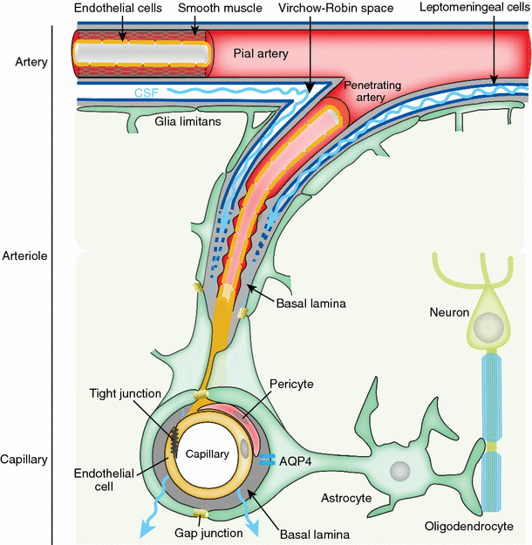

Slide 15
What Drives Glymphatic Influx?
Glymphatic transport of CSF along the periarterial spaces, followed by convective flow through the brain parenchyma, and exit of interstitial fluid (ISF) along the perivenous space to the cervical lymph system, is an energy requiring process that is driven by multiple mechanisms.
The constant production of CSF by the choroid plexus creates a pressure that dictates the direction of the fluid flow through the ventricular system to the subarachnoid space. In addition, several lines of work show that respiration is instrumental in movement of CSF through the aqueduct.
Entry of CSF along the perivascular space is crucial for facilitating glymphatic ISF–CSF exchange and clearance function.
glymphatic activity, at least in part, is driven by arterial pulsatility and explains why perivascular influx occurs preferentially around pulsating arteries and not cerebral veins.

Slide 16
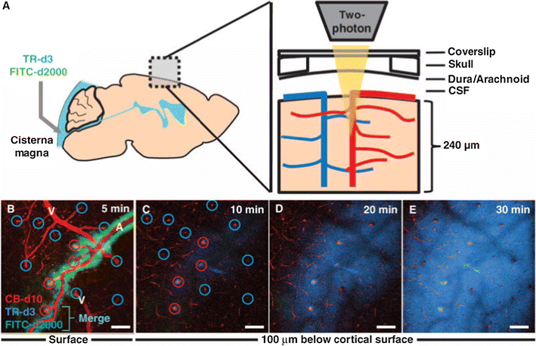

Slide 17
The Glymphatic System is Turned on During Sleep
the sleep state is unique in the sense that glymphatic activity is dramatically enhanced, while its function is suppressed during wakefulness.
A major driver of arousal is the neuromodulator norepinephrine .
norepinephrine also is a key regulator of glymphatic activity and that norepinephrine might be responsible
for suppression of glymphatic during wakefulness.

Slide 18
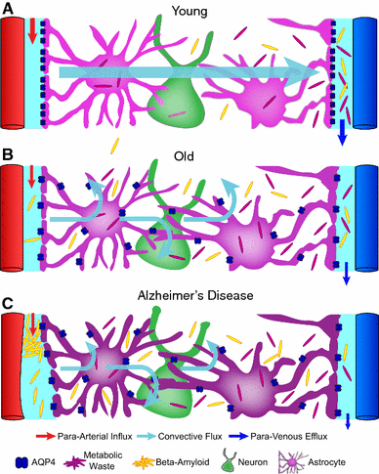

Slide 19
Neurological illness and glymphatic malfunction
Alzheimer D
Edema
Hydrocephalus
Trauma
Psychiatric disease
Sleep impairment
Aging is also accompanied by stiffening of the arterial wall leading to a reduction in arterial pulsatility, which is one of the drivers of glymphatic influx

Slide 20
