Slide 1
Determinantes del clima
Y
Calentamiento global

Slide 2
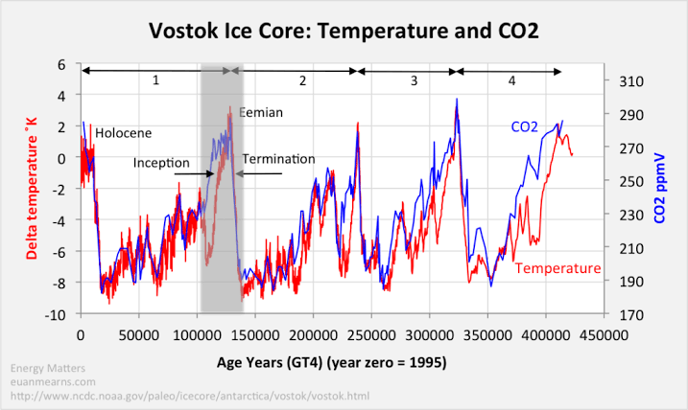

Slide 3
Hay una correlacion casi total entre niveles de CO2 y temperatura.
Correlacion no significa causalidad. Pero hay que notar lo siguiente:
En la subida, el aumento en la CO2 antecede el aumento de temperatura.
En bajada, el descenso en temperatura precede la bajada en CO2
Interpretacion: el aumento de CO2 hace que la luz no pueda salir de la atmosfera, transforma su energía (luminosa) en calor, el cual aumenta la temperatura.
Una vez alcanzado un cierto nivel de CO2 la luz misma no sale y la superficie empieza a enfriarse.
Otros factores, como por ejemplo la albedo, la “blanquitud”, que refleja la luz, también entran en juego y no son contemplados en esta relación

Slide 4
Preguntas abiertas
Porque los cambios climáticos no son iguales en todas partes
Algunos lugares tienen mas precipitaciones
Otros tienen mas sequias
Algunos tienen aumento de la temperatura,
Otros tiene descenso
Hay que entender los detalles de los determinantes del clima

Slide 5
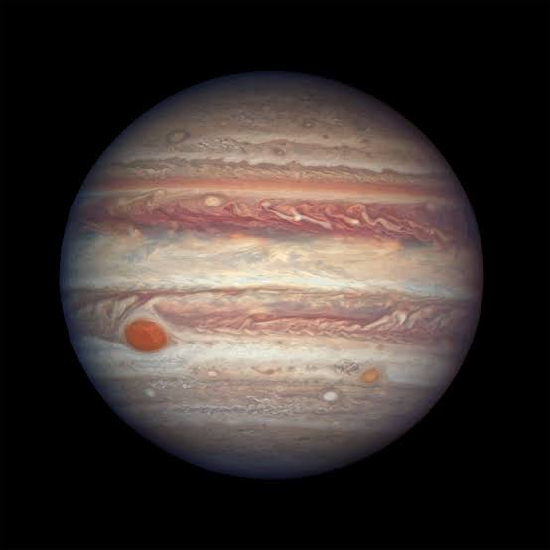
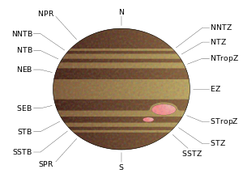
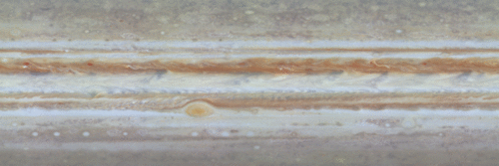
Jupiter
https://en.wikipedia.org/wiki/Atmosphere_of_Jupiter#/media/File:PIA02863_-_Jupiter_surface_motion_animation.gif

Slide 6
The visible surface of Jupiter is divided into several bands parallel to the equator. There are two types of bands: lightly colored zones and relatively dark belts.^{[6]} The wider Equatorial Zone (EZ) extends between latitudes of approximately 7°S to 7°N. Above and below the EZ, the North and South Equatorial belts (NEB and SEB) extend to 18°N and 18°S, respectively. Farther from the equator lie the North and South Tropical zones (NtrZ and STrZ).^{[6]} The alternating pattern of belts and zones continues until the polar regions at approximately 50 degrees latitude, where their visible appearance becomes somewhat muted.^{[31]} The basic belt-zone structure probably extends well towards the poles, reaching at least to 80° North or South.^{[6]}
The difference in the appearance between zones and belts is caused by differences in the opacity of the clouds. Ammonia concentration is higher in zones, which leads to the appearance of denser clouds of ammonia ice at higher altitudes, which in turn leads to their lighter color.^{[16]} On the other hand, in belts clouds are thinner and are located at lower altitudes.^{[16]} The upper troposphere is colder in zones and warmer in belts.^{[6]} The exact nature of chemicals that make Jovian zones and bands so colorful is not known, but they may include complicated compounds of sulfur, phosphorus and carbon.^{[6]}
The Jovian bands are bounded by zonal atmospheric flows (winds), called jets. The eastward (prograde) jets are found at the transition from zones to belts (going away from the equator), whereas westward (retrograde) jets mark the transition from belts to zones.^{[6]} Such flow velocity patterns mean that the zonal winds decrease in belts and increase in zones from the equator to the pole. Therefore, wind shear in belts is cyclonic, while in zones it is anticyclonic.^{[22]} The EZ is an exception to this rule, showing a strong eastward (prograde) jet and has a local minimum of the wind speed exactly at the equator. The jet speeds are high on Jupiter, reaching more than 100 m/s.^{[6]} These speeds correspond to ammonia clouds located in the pressure range 0.7–1 bar. The prograde jets are generally more powerful than the retrograde jets.^{[6]} The vertical extent of jets is not known. They decay over two to three scale heights^{[a]} above the clouds, while below the cloud level, winds increase slightly and then remain constant down to at least 22 bar—the maximum operational depth reached by the Galileo Probe.^{[17]}
The visible surface of Jupiter is divided into several bands parallel to the equator. There are two types of bands: lightly colored zones and relatively dark belts.^{[6]} The wider Equatorial Zone (EZ) extends between latitudes of approximately 7°S to 7°N. Above and below the EZ, the North and South Equatorial belts (NEB and SEB) extend to 18°N and 18°S, respectively. Farther from the equator lie the North and South Tropical zones (NtrZ and STrZ).^{[6]} The alternating pattern of belts and zones continues until the polar regions at approximately 50 degrees latitude, where their visible appearance becomes somewhat muted.^{[31]} The basic belt-zone structure probably extends well towards the poles, reaching at least to 80° North or South.^{[6]}
The difference in the appearance between zones and belts is caused by differences in the opacity of the clouds. Ammonia concentration is higher in zones, which leads to the appearance of denser clouds of ammonia ice at higher altitudes, which in turn leads to their lighter color.^{[16]} On the other hand, in belts clouds are thinner and are located at lower altitudes.^{[16]} The upper troposphere is colder in zones and warmer in belts.^{[6]} The exact nature of chemicals that make Jovian zones and bands so colorful is not known, but they may include complicated compounds of sulfur, phosphorus and carbon.^{[6]}
The Jovian bands are bounded by zonal atmospheric flows (winds), called jets. The eastward (prograde) jets are found at the transition from zones to belts (going away from the equator), whereas westward (retrograde) jets mark the transition from belts to zones.^{[6]} Such flow velocity patterns mean that the zonal winds decrease in belts and increase in zones from the equator to the pole. Therefore, wind shear in belts is cyclonic, while in zones it is anticyclonic.^{[22]} The EZ is an exception to this rule, showing a strong eastward (prograde) jet and has a local minimum of the wind speed exactly at the equator. The jet speeds are high on Jupiter, reaching more than 100 m/s.^{[6]} These speeds correspond to ammonia clouds located in the pressure range 0.7–1 bar. The prograde jets are generally more powerful than the retrograde jets.^{[6]} The vertical extent of jets is not known. They decay over two to three scale heights^{[a]} above the clouds, while below the cloud level, winds increase slightly and then remain constant down to at least 22 bar—the maximum operational depth reached by the Galileo Probe.^{[17]}

Slide 7
The origin of Jupiter's banded structure is not completely clear, though it may be similar to that driving the Earth's Hadley cells. The simplest interpretation is that zones are sites of atmospheric upwelling, whereas belts are manifestations of downwelling.^{[32]} When air enriched in ammonia rises in zones, it expands and cools, forming high and dense clouds. In belts, however, the air descends, warming adiabatically as in a convergence zone on Earth, and white ammonia clouds evaporate, revealing lower, darker clouds. The location and width of bands, speed and location of jets on Jupiter are remarkably stable, having changed only slightly between 1980 and 2000. One example of change is a decrease of the speed of the strongest eastward jet located at the boundary between the North Tropical zone and North Temperate belts at 23°N.^{[7][32]} However bands vary in coloration and intensity over time (see below). These variations were first observed in the early seventeenth century.^{[33]}

Slide 8
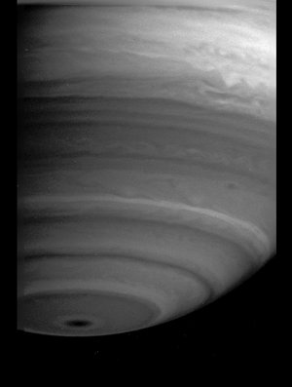
Saturn

Slide 9
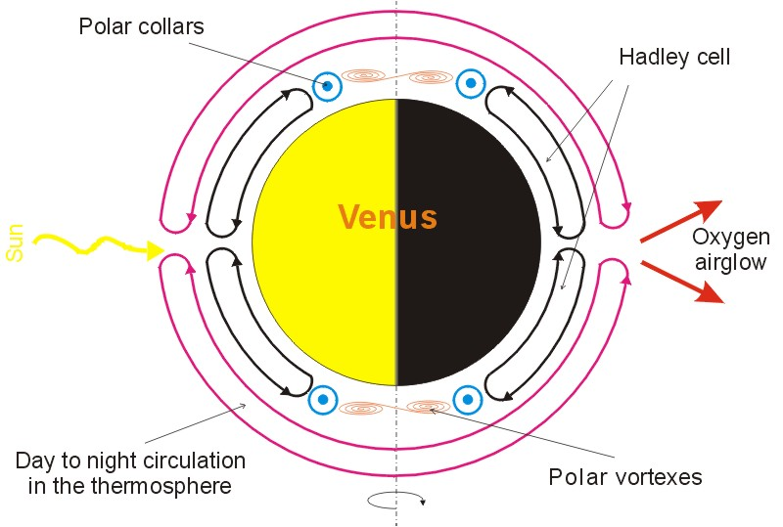
Venus

Slide 10
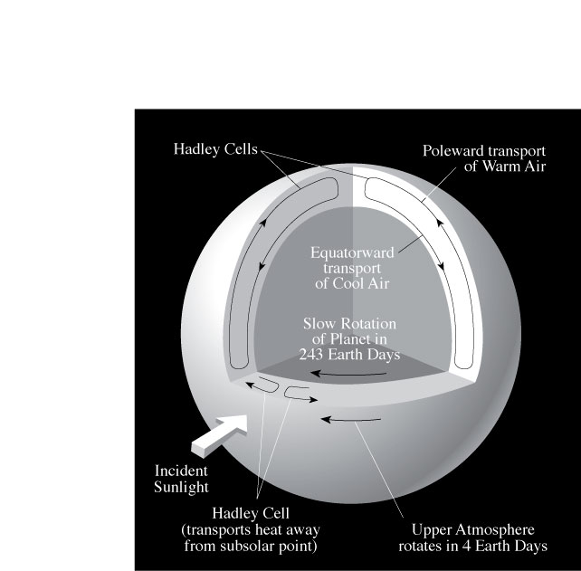
Venus

Slide 11
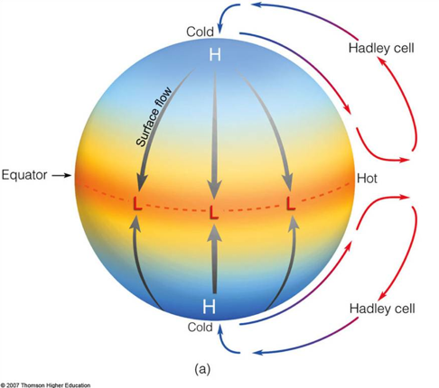
Hadley cell

Slide 12
Earth:
Hadley cells
Temporal and spatial differences in illumination induce differential heating in the Surface of Earth. Main factors:
Night and Day and the Spin of the Earth:
heat flows from illuminated to non illuminated
half of the planet
During the day,
more heat hits 1 cm² at the Equator than at the Poles

Slide 13
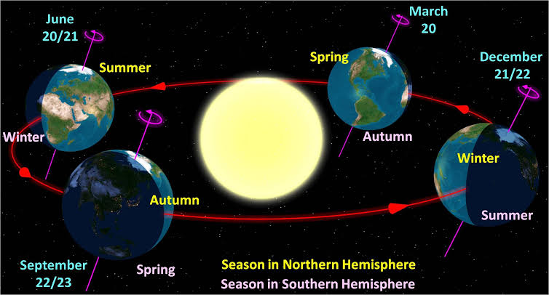

Slide 14
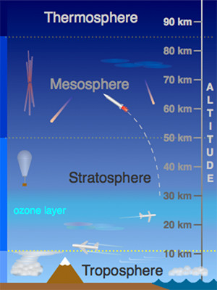
Earth Atmospheric Currents
Law of gases:
PV = nRT
Hotter elements of gases expand and/or
increase their pressure
(and viceversa).
This is the origin of breeze, winds, hurricanes, and all atmospheric phenomena
The atmosphere has:
- Vertical (altitude) Convection movement, and
- Surface (horizontal: S-N, and W-E) movements

Slide 15
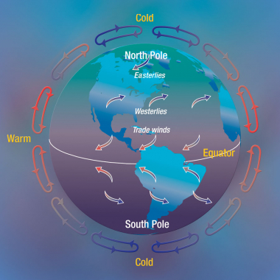
Convection currents

Slide 16
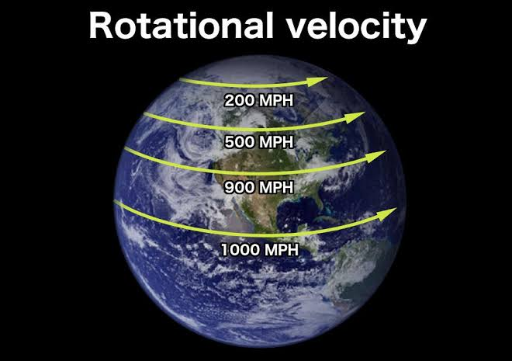

Slide 17
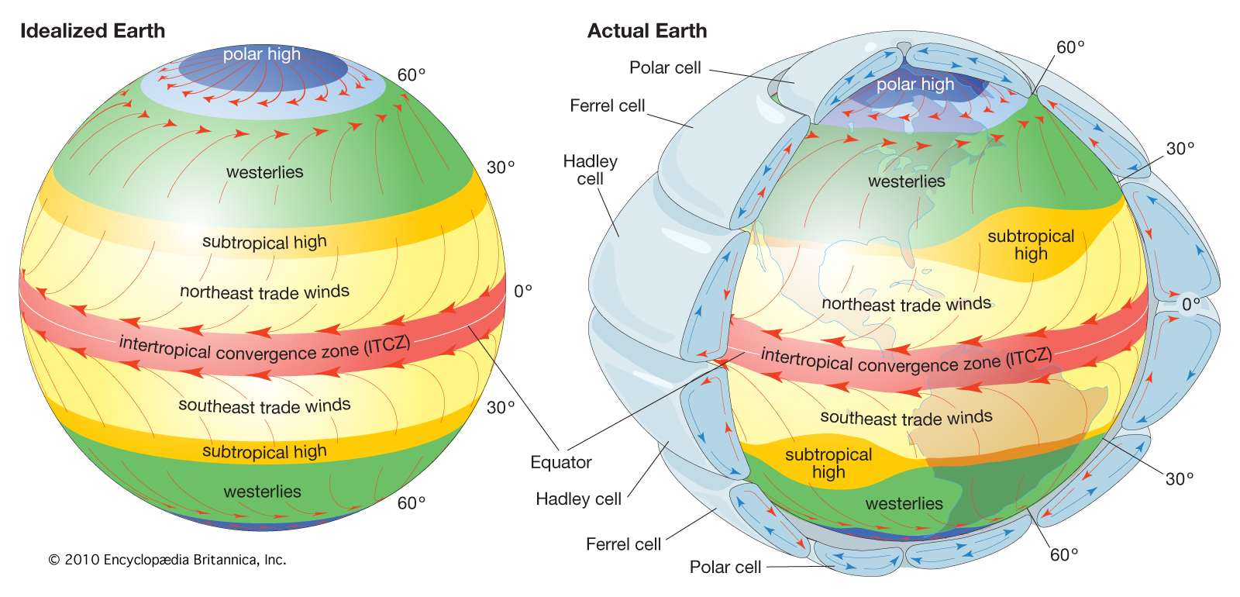
Convection, Surface and Altitude Currents

Slide 18
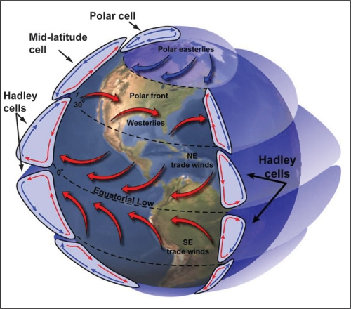
Earth atmospheric circulation cells
The atmosphere transports heat throughout the globe extremely well, but present-day atmospheric characteristics prevent heat from being carried directly from the equator to the poles. Currently, there are three distinct wind cells - Hadley Cells, Ferrel Cells, and Polar Cells - that divide the troposphere into regions of essentially closed wind circulations. In this arrangement, heat from the equator generally sinks around 30° latitude where the Hadley Cells end. As a result, the warmest air does not reach the poles. If atmospheric dynamics were different, however, it is plausible that one large overturning circulation per hemisphere could exist and that wind from the low-latitudes could transport heat to the high-latitudes. As an explanation for equable climates, Brian Farrell presented this idea in 1990 and advocated that during equable climates, the Hadley Cells extended from the equator to the poles (Farrell, 1990).
Hadley Cells are the low-latitude overturning circulations that have air rising at the equator and air sinking at roughly 30° latitude. They are responsible for the trade winds in the Tropics and control low-latitude weather patterns. Held and Hou (1980) outlined the dynamics of this circulation through a simplified model of the Hadley Cell. For the model, there are three main assumptions. First, the Hadley Cell circulation is constant. Second, the air moving toward the poles in the upper atmosphere conserves its axial angular momentum, while the surface air moving equatorwards is slowed down by friction. Third, the thermal wind balance holds for the circulation (Vallis, 2006). For simplicity, the model is also symmetric around the equator. These initial assumptions make the explanation of Hadley Cell dynamics much simpler.

Slide 19
Hadley cell expansión caused by increase in temperature

Slide 20
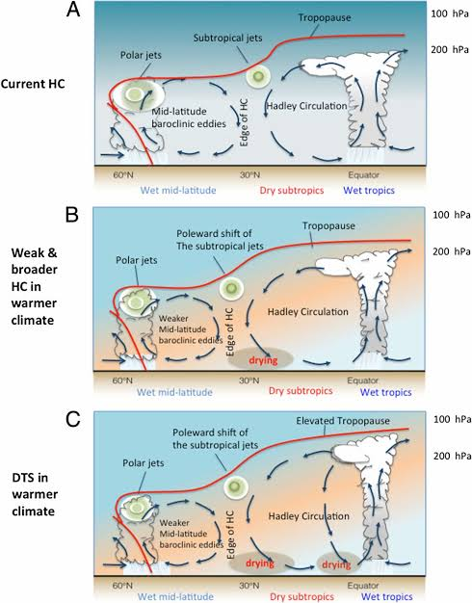
Associated changes in precipitation

Slide 21
Besides the two factors that we described
difference in illumination between
night vs. day and
- equatorial vs. polar
WHAT OTHER FACTORS
DETERMINE LOCAL CLIMATE?

Slide 22
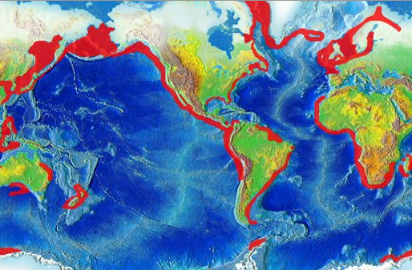
What moves great quantities of HEAT?
Sea currents:
Importance of the geographical profiles of the land masses
Oceanic circulation: horizontal and vertical
Upwelling zones

Slide 23
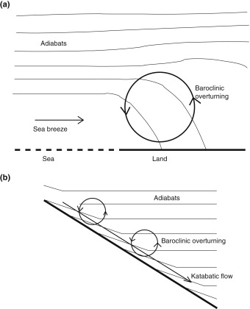
Night breeze phenomenon

Slide 24
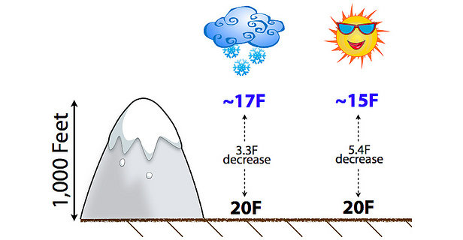
Land altitude profile

Slide 25
Conclusions:
An increase in heating induces
1) More rainfall in teh equatorial-tropical latitude
2) An expansión in the latitudinal size of Hadley cell, with the consequent expansión of the dry zone at the interface between the Hadley cell and the intermediate zone of the Earth
3) This is the cause of the increase in desertification
4) Specific variations in local (micro)climates are determined by more complicated factors related to the shape of the Earth continental landmasses and sea current circulation, together with the precise altitude profiles of the landmasses
5) Any model of microclimate must keep into account complex variables

